Slide 1
Vietnam War Legacies & Reconciliation
U.S. Institute of Peace
Lesson

Slide 2
Essential Question:
Why is it important to tell personal stories as part of the effort to heal after war?

Slide 3
WARM UP:
During war, some service members and civilians are killed in action and their bodies are never recovered. What impact might this have on individuals, families, and communities?
Notes:
Teacher notes: Students might discuss a lack of closure for families, continued bitterness both on the individual level and community level, and communities prevented from moving forward.

Slide 4
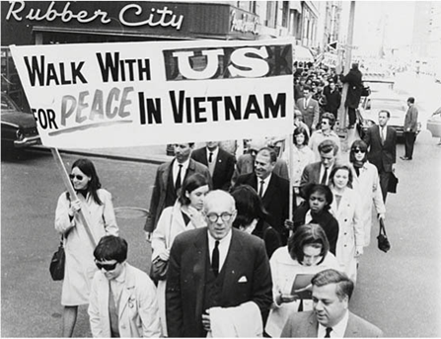
Vietnam War – Brief Background
Image source: Library of Congress
Conflict between communist Vietnam (north) and non-communist Vietnam (south)
The United States was committed to a Cold War policy of containment, and joined South Vietnam in the war
Direct U.S. involvement was from 1965-1972
About 25% of servicemen were drafted; 30% of those killed were drafted
58,000 Americans killed; 3 million Vietnamese killed (⅓ were civilians) between 1961-1974
American forces used an herbicide called Agent Orange to remove forest cover and vegetation and to destroy crops
Dioxin, a chemical in Agent Orange, later proved to cause serious health issues, including cancer, among both American soldiers and Vietnamese soldiers and civilians

Slide 5
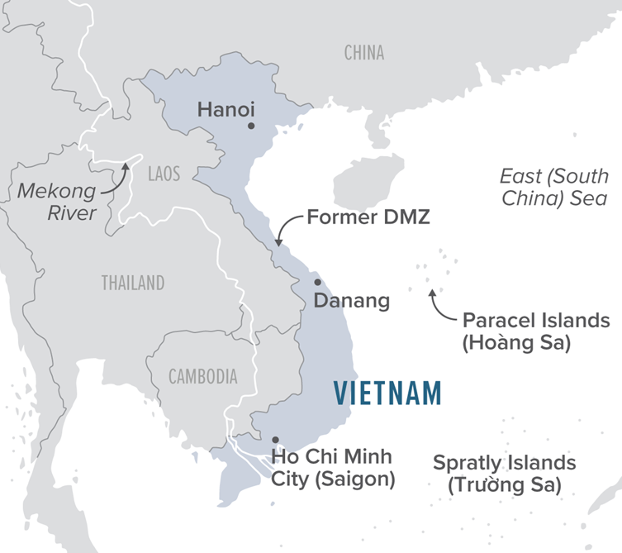
Geography of Vietnam
Image source: USIP
Notes:
Teacher note: Teachers may wish to highlight the crescent shape of Vietnam and identify key places such as the former DMZ and Ho Chi Minh City. It is worthwhile to show the proximity to Cambodia and Laos. An extension activity might include investigating the war legacies in those individual countries.

Slide 6
Discussion Questions:
What is reconciliation?
After the Vietnam War, what groups needed to be reconciled?
What kinds of things might need to be reconciled between these groups?
Notes:
Teacher notes:
-Definition: the restoration of friendly relations
-Groups that need to be reconciled include the North and South Vietnamese, the U.S. and Vietnam, and Americans who supported the war and those who did not.
-Students might identify that the two counties need to agree to the terms of peace, someone might need to take responsibility, physical devastation needs to be repaired, and so on.

Slide 7
USIP Vietnam War Legacies and Reconciliation Initiative
In 2021, the U.S. Institute of Peace launched a multiyear project to foster greater dialogue both in and between the United States and Vietnam on war legacy issues and reconciliation.
This project stems from the U.S. Congress’s landmark 2021 authorization for the U.S. government to assist Vietnam in identifying its missing personnel, following decades of Vietnamese cooperation to help the United States conduct the fullest possible accounting of U.S. personnel.
The project will support the bilateral initiative while also engaging in the work that remains to address legacies of war — including the continuing impacts of Agent Orange and unexploded ordnance — and to deepen reconciliation.
Notes:
Teacher notes: The USIP website includes many resources related to this initiative. An extension activity could ask students to explore these resources. In addition, if students are unfamiliar with the work of USIP, it could be helpful to explore the history of the Institute to understand why this work is central to USIP’s mission.

Slide 8
U.S. Assistance on War Legacy Issues in Vietnam:
Removal of unexploded ordnance
Assistance to Vietnamese affected by Agent Orange
Accounting of Vietnamese missing war dead
Notes:
Teacher notes:
-Unexploded ordnance (UXO) is also a big issue in Cambodia and Laos. The U.S. government is helping train local teams, empowering them to deal with UXO on the ground, which is a valuable source of employment.
-Agent Orange exposure has resulted in a high population of individual with disabilities. This assistance has included building hospitals and making facilities more accessible.
-The accounting effort will be the focus of this lesson. There were approximately 2,000 Americans missing in action in Vietnam (of which about 750 have since been identified), and over 300,000 Vietnamese missing war dead. While war dead from the Vietnam War affected a couple thousand families in the U.S., it affected almost every family in Vietnam.

Slide 9
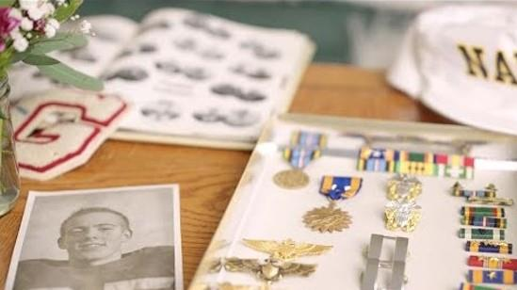
Paul Charvet's Story
Notes:
https://youtu.be/wbrLXzRltho

Slide 10
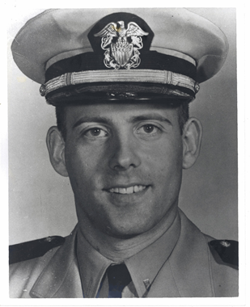
Discussion Question:
How did Paul's MIA status impact his family's ability to grieve his loss?
What impact did the identification of Paul's remains have on his family?
Paul's family mentioned that this will help heal the hatred and ugliness of the Vietnam War. Does this healing happen at the family level? The community level? The national level?
Image source: DPAA​
Image source: DPAA
Notes:
Teacher notes:
-Paul’s family didn’t know what had happened to him, so they had to find closure in other ways. They never expected to learn about his death.
-His sister said now he is back and part of the family, and that is it “glorious” to have him back home. His other sister said she could feel him. The family finally got the closure they had been missing.
-Students should be able to discuss that this healing is happening on the family level, as we see with Paul’s family. Students might also identify that this healing is important for communities (though parades, ceremonies, burials, etc…), and the national level because it helps the nations confirm their commitment to each other as they heal from this war.

Slide 11
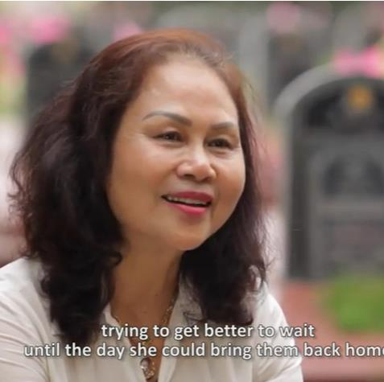
Vietnamese Families Look for Loved Ones
Notes:
https://youtu.be/5Mh1EVZ1CwQ

Slide 12
Discussion Question:
How has the search for Vietnamese war dead been an important part of healing in Vietnam?
What are the similarities and differences between American and Vietnamese families who have lost loved ones in the Vietnam-American War?
Notes:
Teacher notes:
-Vietnamese families have been grieving, and finding loved ones helps with healing and closure. Teachers may point out that this effort is also happening with the support of Americans, which is helping heal the relationship between the two nations.
-Similarities: Family members of all sides are grieving their lost, and without the remains it is hard to get closure. Differences: the war was fought in Vietnam, so it affected the broader population in different ways, including many civilians among the war dead, many Vietnamese families having experienced more financial loss as result, and Vietnamese interest in having ephemera returned.

Slide 13
Defense POW/MIA Accounting Agency
When American personnel remain captive, missing, or otherwise unaccounted-for at the conclusion of hostilities, the DoD accounting community becomes the responsible agent for determining the fate of the missing and where possible, recovering them alive or recovering and identifying the remains of the dead.
For those killed-in-action, the accounting community is charged with locating, recovering, and identifying their remains. More than 81,900 Americans remain missing from World War II, the Korean War, the Cold War, and the Vietnam War.

Slide 14
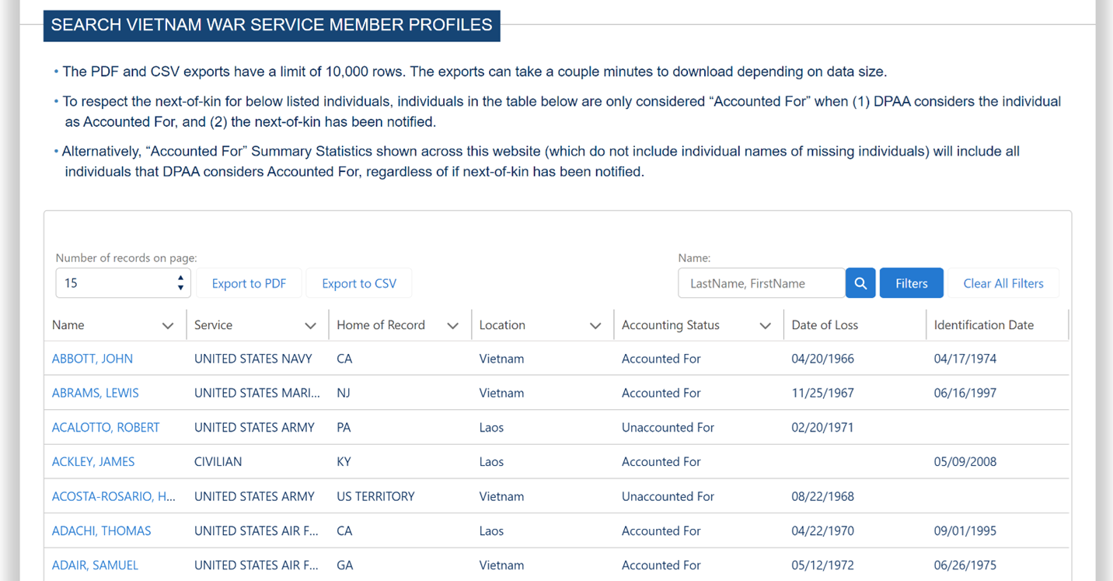
Activity
Goal: Use the DPAA search tool to conduct research on service members from your community

Slide 15
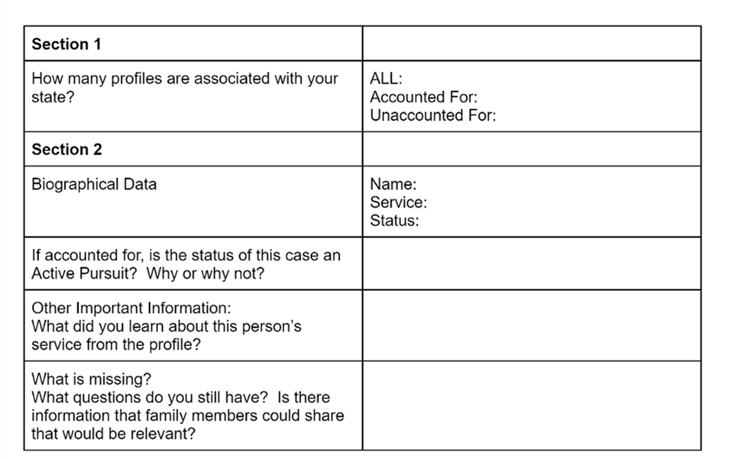
Activity

Slide 16
Debriefing Questions
What is the value of having these profiles online?
What did you learn about your individual state in terms of the accounting effort?
Who is missing from this list?
How could your community better support the efforts with the accounting effort?
Notes:
Teacher notes:
-Students might say that this helps with closure, helps further the research efforts, increases visibility for the public, demonstrates America’s commitment to their soldiers, and could lead to further discovery or identification of MIAs.
-Answers will vary.
-Vietnamese missing war dead, including American allies in Vietnam, whose family members may now live in the U.S.
-Students might discuss increased awareness or visibility, having more people participate in sharing information that could be useful, and identifying descendants who could provide DNA samples.

Slide 17
Transfer Task
Your state is opening a new museum dedicated to the Vietnam War. They would like to include a special exhibit dedicated to the War Legacies and Reconciliation effort, and they have asked for your help in planning the content of the exhibit. Create a proposal to submit to the museum board with your ideas for the exhibit.

Slide 18
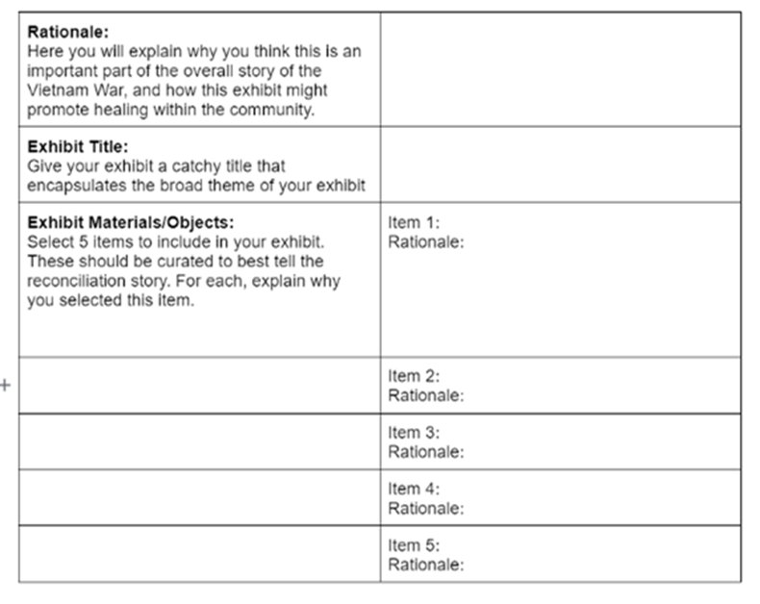
Create Your Proposal
Notes:
Teacher notes: Encourage students to select 5 items that represent a theme. Are they focusing on a specific aspect of reconciliation, such as MIAs? Do they want to focus on their hometown? How might different materials tell the story in different ways? Remind students that personal objects, photos, and other historical documents might be appropriate to include.

Slide 19
Final Debrief
How has the accounting of MIA helped the United States and Vietnam heal from the wounds of war?
Where do we go from here? What do you think communities should be doing to support reconciliation? Is it more important for the action to happen at the federal, state, or local level?
Notes:
Teacher notes:
-The accounting effort has resulted in healing for families who have been lucky enough to have the remains identified and returned. It is also a symbol of hope for the families of those who are still MIA and shows the commitment that their government has to those who have sacrificed their lives in this conflict.
-Students might place more emphasis on federal, state, or local level. Through the discussion, help students identify the importance of all stakeholders participating in this critical effort. Teachers and students might also consider Vietnamese immigrant communities in the U.S. For example, there’s no database for finding missing Vietnamese from either side. There are only U.S. soldiers on the Vietnam Veterans Memorial in D.C., and no names of U.S. allies in Vietnam.

