Slide 1

World Bank Support for Haiti’s Recovery
Alexandre Abrantes
Special Envoy to Haiti
January 2011

Slide 2
Outline
WBG Response
Portfolio
Private Sector
Results
New Projects
One Year On
2011 & Beyond

Slide 3


Slide 4
WBG Response
WBG pledged US$479m for 2010-2011
US$340m has been delivered in new funding, disbursements, private sector support, and debt relief.
WBG Pledge of Support to Haiti NY International Conference on Haiti - March 31, 2010
Support | Pledge to end 2011 | Delivered end 2010
New Funding IDA + Trust Funds | US$130 | US$123
Disbursements New + Existing Projects | US$250 | US$129
Private Sector Support | US$60 | US$49
Debt Relief | US$39 | US$39
TOTAL | US$479 | US$340

Slide 5
Portfolio
16 projects for US$337 million, of which US$143m have been disbursed for emergency, reconstruction & development
Budget support of US$42.5m was provided in 2010
Infrastructure, Community-Driven Development, Education, Transport, Water & Sanitation, Energy, Agriculture, Economic Governance

Slide 6
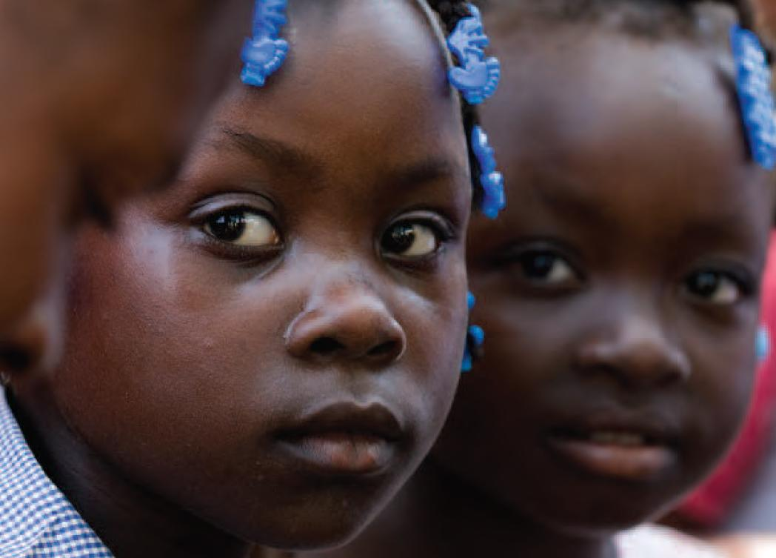
Education for All

Slide 7
Private Sector
IFC: 5 new projects for US$49.6m; 3 projects in garments, hotels, energy and mining for US$15.3m are under implementation
Trade finance guarantee, finance of SMEs, and 30MW energy projects were approved prior to the quake
Structured the international bidding process for TELECO, which brought a US$100m investment by Vietnam’s Viettel in May 2010

Slide 8
Private Sector
Potential: access to US market, absence of protracted ethnic violence, abundance of affordable labor
Corporations can offer expertise in remaining gaps, such as housing shortages and vocational training
Investment opportunities: tourism, garments, animal husbandry, fruits and tubers, housing, banking, energy
Strategic philanthropy: improving social entrepreneurship and building local resilience.

Slide 9
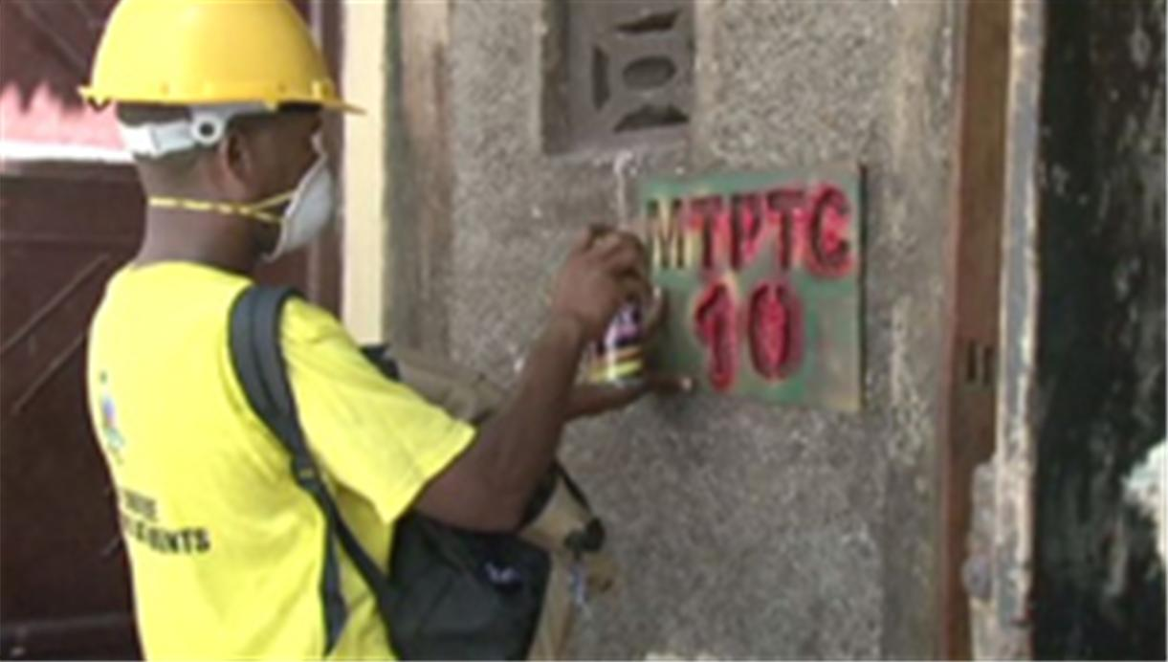
Building Assessment

Slide 10
Results
Structural assessment of 400k buildings in Port au Prince
Removal of 100k m³ of debris from drainage canals
Provision of 50k solar lanterns to families
Food supplements for 200k children under two and health care for pregnant women and infants (WFP, PAHO)
Funded 180k children to attend school and fed 80k school children a hot meal every day
Six water supply systems, benefitting 37k people in rural Haiti
Housed and equipped Ministry of Finance (500 staff)
Supported the creation of 5k new jobs and safeguarded 5k existing ones

Slide 11

Canal Clearing

Slide 12
New Projects
US$95m Housing Reconstruction Project (IDA + HRF)
US$15m Cholera Emergency Project
US$11m Line Item Budget Support for Education & Agriculture
US$3m to establish a US$35m Partial Risk Guarantee Fund for private operators in Haiti (IDA, IDB, USA, HRF)

Slide 13
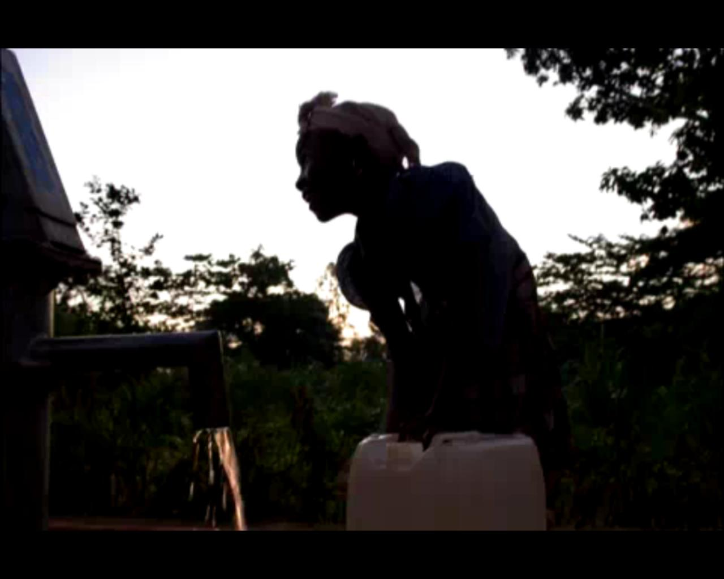
Rural Community Development

Slide 14
One Year On
At 12 months, evaluation of progress should focus on the emergency response.
Reconstruction started mid-2010 but will take several years
It takes time everywhere – Aceh (Indonesia), even in the US (Katrina), with well functioning central governments
Government capacity to catalyze and coordinate needs to be strengthened

Slide 15
One Year On
Some macroeconomic indicators are improving: reserves, inflation, revenue, growth (11% in 2011, 6-8% after)
Frameworks for key sectors exist: housing, debris, private sector, health, education
IHRC and HRF function: IHRC endorsed US$2b in projects in 2010; HRF received US$256m and allocated US$193m

Slide 16
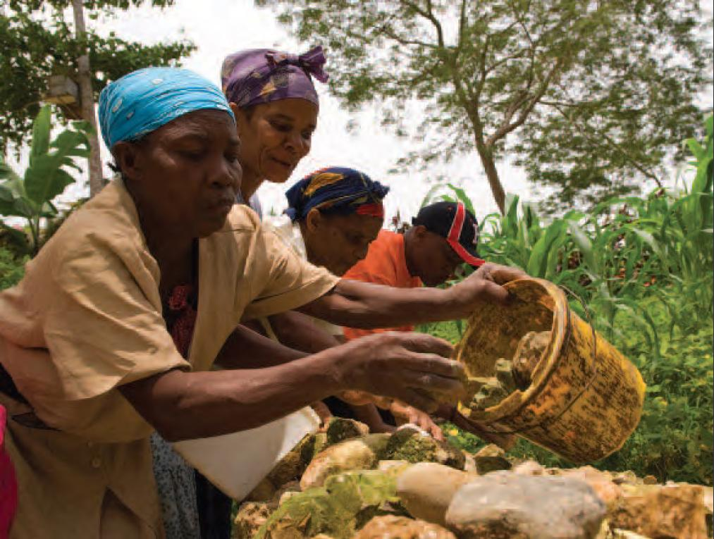
Rural Community Development

Slide 17
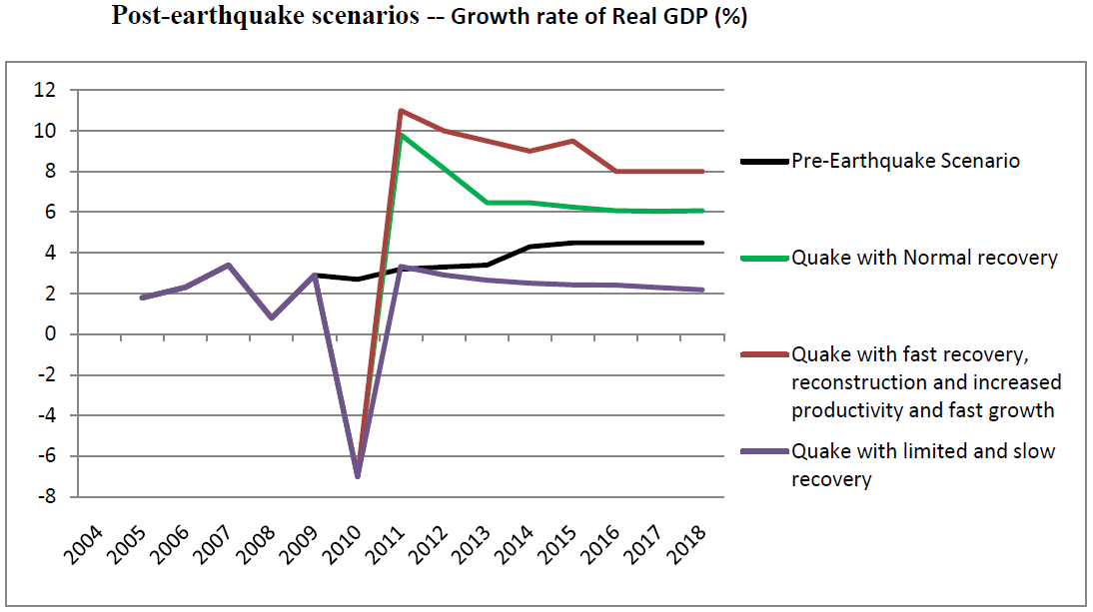
2011 & Beyond

Slide 18
Thank You
aabrantes@worldbank.org

