Slide 1

Helping Haiti Rebuild
U.S. Government post-earthquake strategy
U.S. Institute of Peace
January 26, 2011

Slide 2
Pledges By Donor & Against GOH Reconstruction Priorities
Pledges by Donor
Pledges Against GOH Priorities
Haiti
Reconstruction
Fund
Technical
Assistance
Budget
Support
1%
1%
Project
Assistance
Unallocated
Venezuela
IDB
USA
EU - Total
World Bank
Canada
Inter-Action*
Red Cross
UNASUR*
IMF
Brazil
All Others
Total
* Inter-Action is a consortium of humanitarian NGOs; UNASUR is the Union of South American Nations. Source: IHRC, http://www.cirh.ht/pledges.html

Slide 3
USG Strategy Framework
Five
Principles
USG assistance will be country-led and build country capacity
Four
Pillars
Three Corridors
Infrastructure and Energy
Two Objectives
Cap Haitien Corridor
One
Goal
USG assistance will be comprehensive and integrated
Catalyze economic growth
Food and Economic Security
A stable and more prosperous Haiti
Saint Marc Corridor
USG assistance will leverage and be coordinated with the resources of other partners, including the private sector
Health and Other Basic Services
Build long-term stability
USG assistance will leverage multi-lateral mechanisms where appropriate
Port-au-Prince Corridor
Governance and
Rule of Law
USG assistance will be sustained and accountable
Commitment
Focus
Results

Slide 4
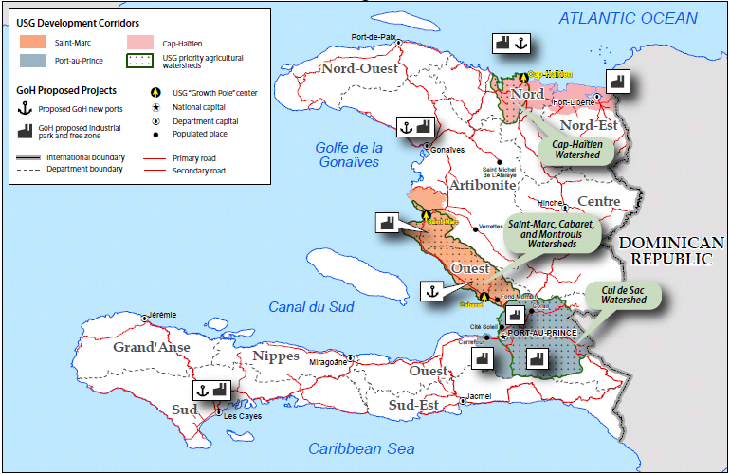
Development Corridors

Slide 5
Development Pillars
1
Temporary and permanent shelter
Rubble removal
Housing finance
Housing
Ports and Economic Growth Poles
Port efficiency
Regulatory environment and oversight
Major international container port
Growth pole anchored by port development
Infrastructure and Energy
Modernized electricity sector
Alternative cooking technologies
Energy
2
Agriculture and Nutrition
Agriculture sector growth
Improved nutritional status
Food and Economic Security
Support to MSMEs
Enabling policy environment
TA, professional, vocational training
Access to capital

Slide 6
Development Pillars
3
Access to health and nutrition services
Ministerial capacity building
Public health infrastructure
Public Health
Health and Other Basic Services
Education and Youth-Focused Services
GOH institutional capacity building
Complementary youth-focused services, including through PPPs
4
Credible electoral and legislative process
Public administration, civil service reform
Local governance capacity building
Governance
Governance and Rule of Law
Protection of human rights and vulnerable populations
Administration of justice
Security sector reform and capacity building
Transparency and accountability
Rule of Law

Slide 7
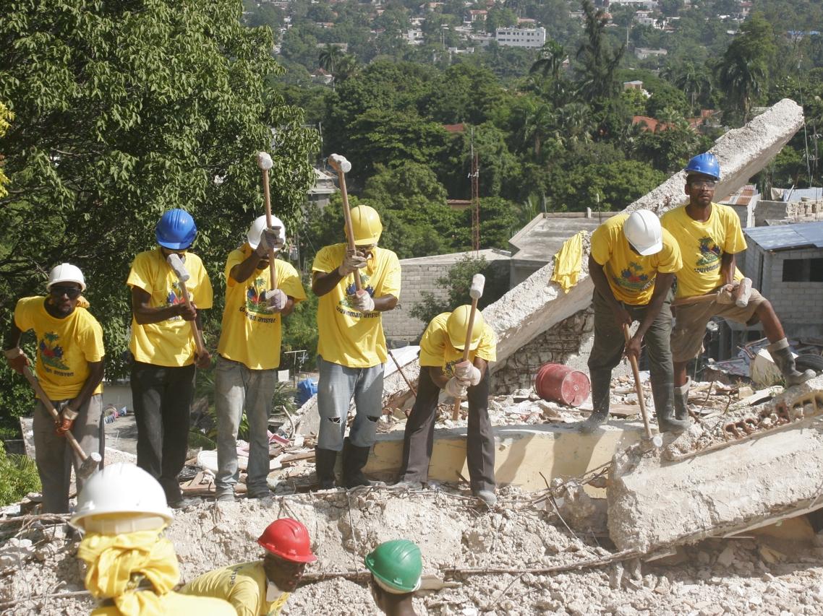
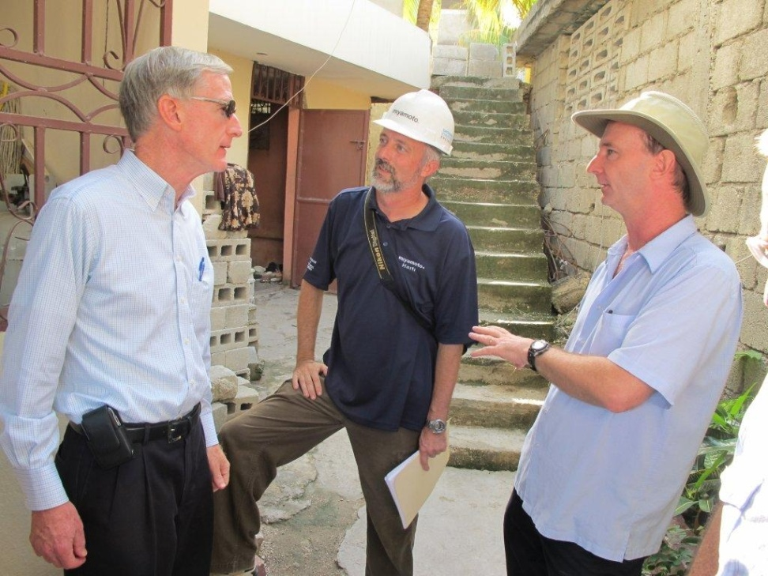
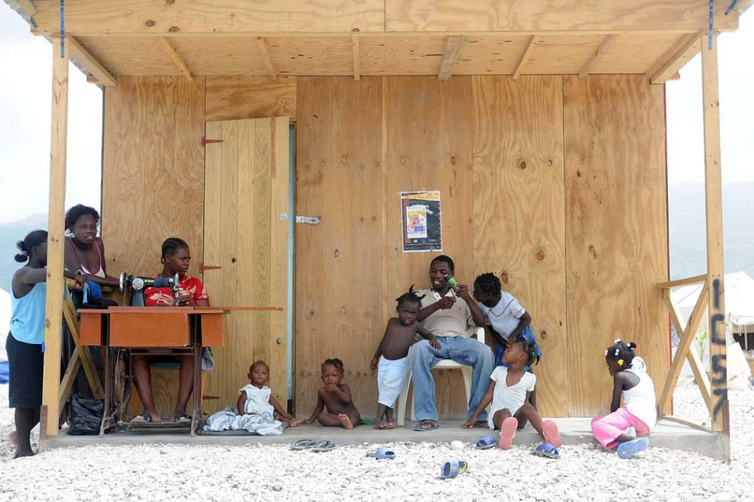
Meeting Immediate Needs • Working for Sustainable Development
The United States has provided short term work for more than 350,000 people, about half of whom are women, through the OTI cash for work program.
We have assessed 380,000 homes and found 54% safe to live in.
The United States worked with the Government of Haiti, the IHRC, the Inter-American Development Bank, and a major Korean textile firm to fund a new industrial park in the northern region, which will create 20,000 jobs in the first phase alone, and grow to support 65,000 jobs when the park is fully developed.
The United States has helped build over 13,000 temporary shelters representing approximately 50 % of the total shelters built by the international community.
The United States is supporting the reopening of schools post-quake through programs such as USAID’s PHARE program, which built classrooms in Port-au-Prince.

